Slide 1

Module 3 –In Memory Computation
Spark Architecture

Slide 2


BIG DATA
Spark Architecture
Requests cluster manager for workers to run operations
This is the master for your spark application
The driver packages the transformations and actions and creates tasks on workers
https://spark.apache.org/docs/latest/cluster-overview.html

Slide 3
BIG DATA
Workflow of Spark Architecture
Input Data
Where to run the tasks
Do we have all the data to move forward

Slide 4
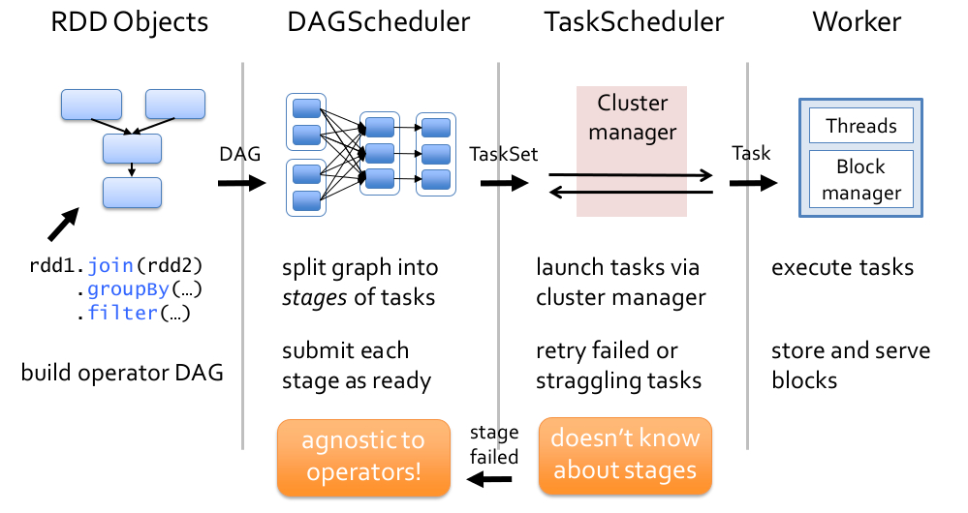
BIG DATA
Spark Working details
https://hxquangnhat.com/2015/04/03/arch-spark-job-submission-breakdown/

Slide 5
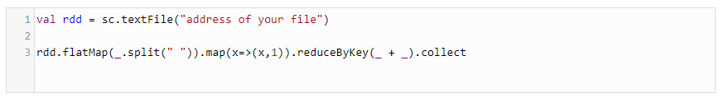
In Memory Computation-Spark
Spark Internal Working – Jobs, stages and Tasks
Step 1:

Slide 6
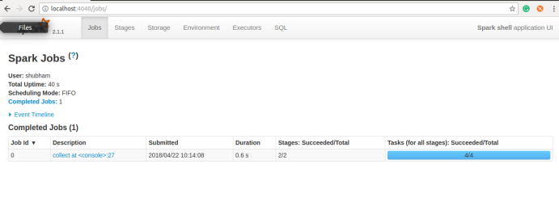
In Memory Computation-Spark
Spark Internal Working – Spark Context
Step 2:

Slide 7
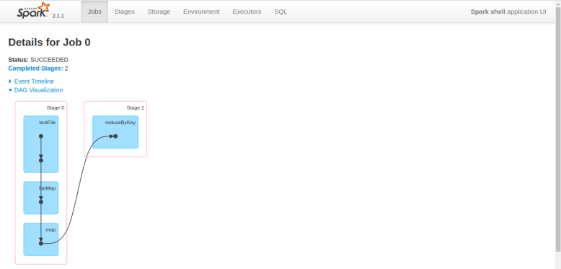
In Memory Computation-Spark
Spark Internal Working – DAG
Step 3:
Why two stage?
Depends on Shuffling
Transformation that needs communication to other partition.

Slide 8

In Memory Computation-Spark
Spark Internal Working – Tasks
Step 4:
It depends on your number of partitions.

Slide 9
Lazy Execution in Spark- When the execution starts?
Notes:
Exercise
Write a similar program for
Finding the words in a file
For each word, calculate the count
Assume the file contains the string
“To be or not to be”
Hint
This should be done in parallel
In the blue boxes, read in each line in the file
If the line is w1 w2 w3 w4, then output 4 lines w1 1 w2 1 w3 1 w4 1

Slide 10
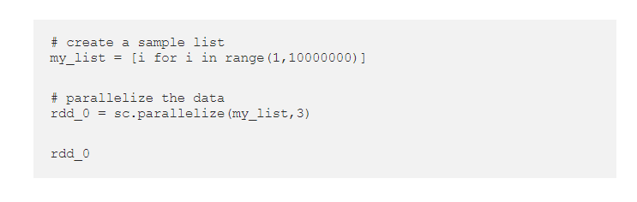
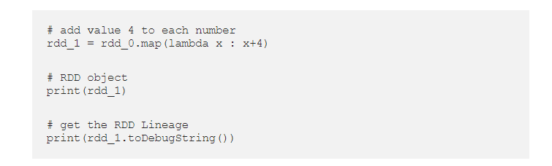

IN MEMORY COMPUTATION_SPARK
LAZY EXECUTION- How does it helps?
Optimization

Slide 11
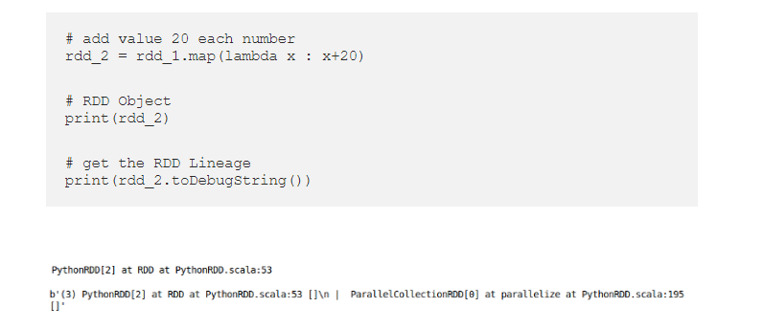
IN MEMORY COMPUTATION_SPARK
LAZY EXECUTION- How does it helps?
Instead 24 would have been added

Slide 12
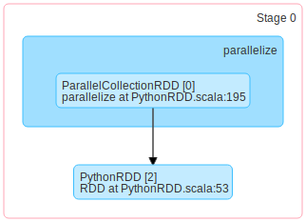
IN MEMORY COMPUTATION_SPARK
LAZY EXECUTION- How does it helps?
Instead 24 would have been added

Slide 13

BIG DATA
Spark Working with Log Mining Example
Base RDD
Cache 1
lines = spark.textFile(“hdfs://...”)
errors = lines.filter(startsWithERROR())
messages = errors.map(split(“\t”),2)
cachedMsgs = messages.cache()
Worker
Transformed RDD
results
tasks
Block 1
Driver
Action
cachedMsgs.filter(containsfoo()).count()
cachedMsgs.filter(containsbar()).count()
Worker
Cache 3
Worker
Block 2
Block 3

Slide 14
THANK YOU

